Slide 1
UK Accidents 2019
Exploratory Data Analysis in R
Created by: Oliver Freimuth

Slide 2
Overview
Skills used
Data & Data Wrangling
Exploratory Data Analysis:
Missing Values
Filtering & Arranging
Visualizations
Creating a Map

Slide 3
Skills used
Base R: sapply(), for loop
Deplyr: select(), filter(), arrange(), rename(), mutate(), glimpse()
ggplot: geom_bar(), geom_point(), geom_smooth(), geom_col()
Leaflet

Slide 4
Data & Data Wrangling
Data source: UK government (Link to be found in the R-file)
Original dataframe contains 117,536 observations of 32 variables
Here a subset is used containing all observations but only 11 columns
10 are taken directly from the original dataset
The column “Month” is created based on the variable “Date”
Categorical variables are adjusted to the type “factor”

Slide 5
Exploratory Data Analysis Missing Values
There is a total of 119 missing values
Time has 63 missing values
Longitude has 28 missing values
Latitude has 28 missing values
Speed limit has 80 observations with the value “-1”, most likely missing values
There is no possibility to impute or substitute most of these missing values in a sensible way
Speed limit is an exception: Based on given latitude and longitude, the speed limit could likely be investigated

Slide 6
Exploratory Data Analysis Filtering & Arranging
There are only 9 accidents that involved at least 10 cars
Investigating the Speed limit:
Most accidents happened at a speed limit of 13
The average number of casualties increases with the speed limit
The maximum number of casualties happened at 60 but seems to be an outlier
Speed limit | 20 | 30 | 40 | 50 | 60 | 70
Number of Accidents | 11,747 | 69,305 | 10,021 | 4,716 | 14,514 | 7,153
Share of Accidents | 10.0% | 59.0% | 8.53% | 4.01% | 12.35% | 6.09%
Average Casualties | 1.15 | 1.23 | 1.41 | 1.48 | 1.51 | 1.57
Max Casualties | 12 | 16 | 19 | 9 | 52 | 13

Slide 7
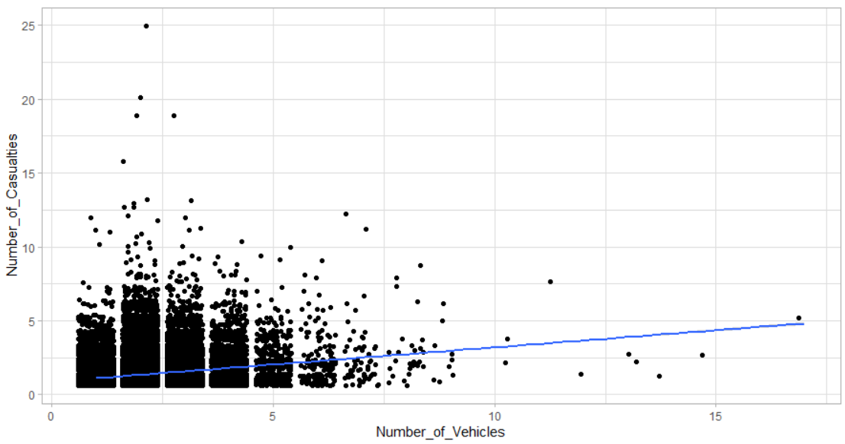
Visualizations Scatter Plot: Number of Casualties vs Number of Vehicles
Points are somewhat displaced to provide an idea how many observations there are
Most observations involve up to five casualties and vehicles
The regression line shows that number of vehicles positively correlates with the number of casualties

Slide 8
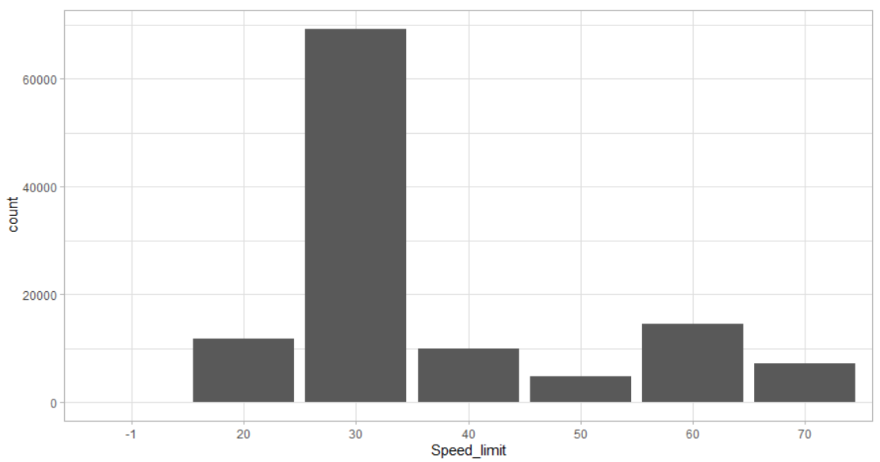
Visualizations Bar Plot: How many accidents occurred at a given speed limit?
Most accidents occur at a speed limit of 30
The least accidents happened at a speed limit of 50
The value -1 most likely indicates a missing value

Slide 9
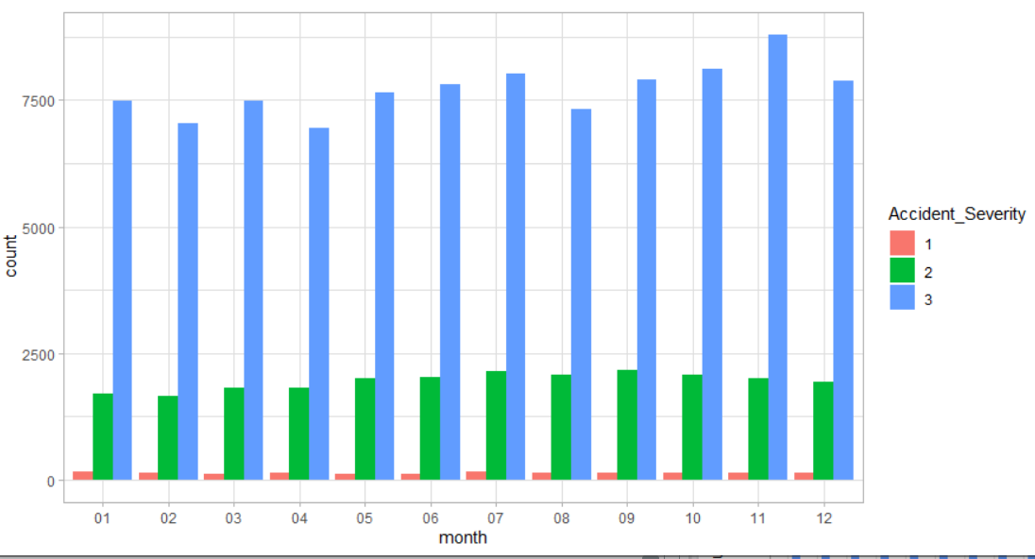
Visualizations Bar Plot: Accident month and Accident Severity (Absolute Numbers)
Most accidents are of severity level 3
Each accident severity peaks at a different month
Accidents of severity level 1 are difficult to investigate from plotting absolute numbers

Slide 10
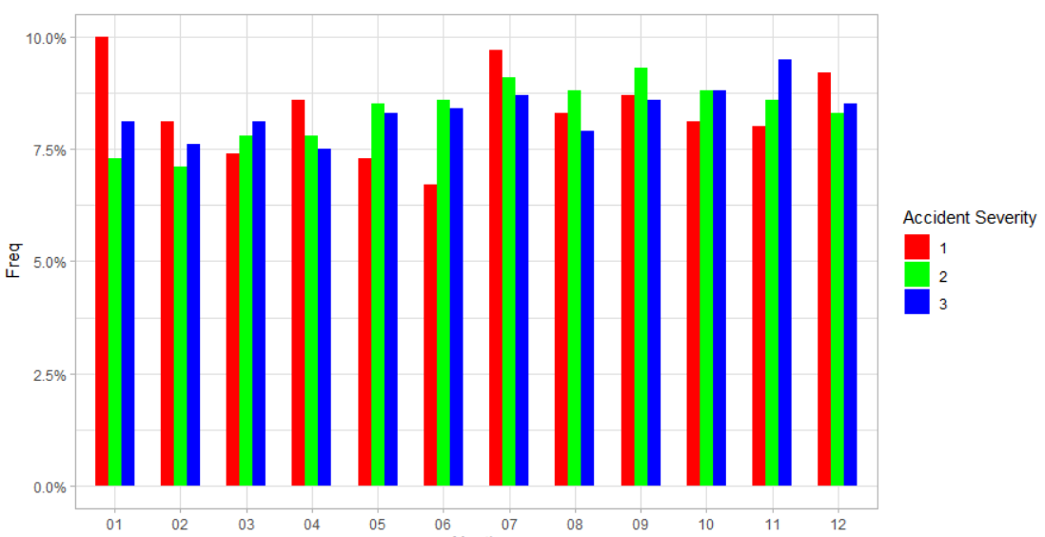
Visualizations Bar Plot: Accident month and Accident Severity (Relative Numbers)
10% of accidents with severity 1 happen in January, which is the maximum
We see that instances of accidents with different severity levels follow different patterns over the year

Slide 11
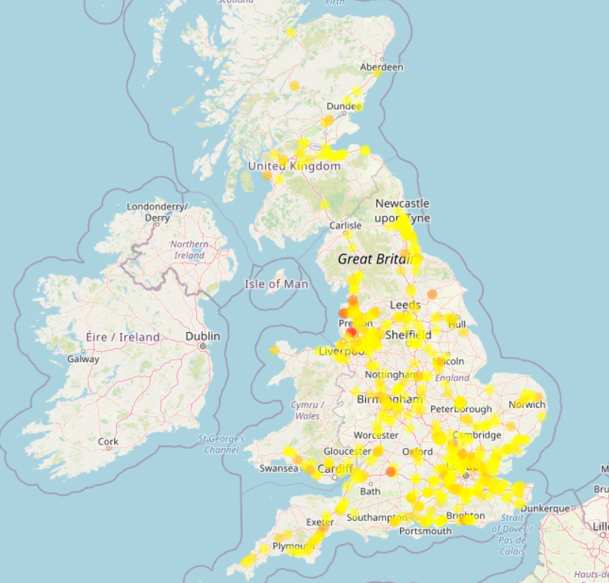
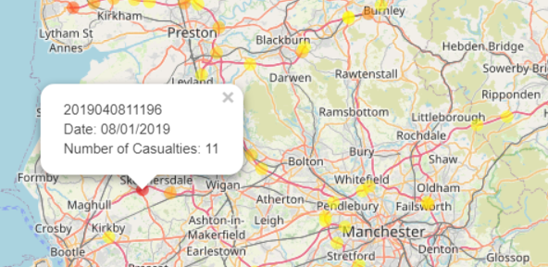
Visualizations Accidents in January at speed limit 70 (n = 576)
Darker markers indicate a higher number of casualties
There seem to be certain hot spots
Some areas are (mostly) free of accidents meeting the parameters

